Slide 1
Fractal
Hill (2nd Edition): 9.1 to 9.3, 9.6
Extra Resource:
https://fractalfoundation.org/fractivities/FractalPacks-EducatorsGuide.pdf
https://math.bu.edu/DYSYS/chaos-game/node6.html

Slide 2
Introduction to Fractal
Self Similarity
They appear the same at every scale, no matter how much enlarged.

Slide 3
Introduction to Fractal
Infinite length within a finite region
Different fractals
Koch Curve
Koch Snowflake
Dragon Curve
Hilbert Curve
Implemented using recursive functions

Slide 4
Introduction to Fractal
Application:
Simulating Clouds, ferns, coastlines, mountains, veins, nerves, parotid gland ducts, etc. all possess these features
Fractal geometry is useful for all sorts of things from biology to physics, to cosmology, to even the stock market
Fractal math is involved in JPG, MP3, MPG and other digital compression

Slide 5
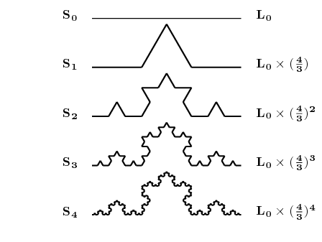
Koch Curve
k₀ (0-th generation)
k₁ (1st generation)
k₂ (2nd generation)
k₃ (3rd generation)
k₄ (4th generation)

Slide 6
Koch Curve
Initial line: k_{o}
horizontal line having unit length
1st generation: k₁
divide k_{o} in three equal parts
replace the middle section with triangular bump each side having length 1/3
2nd generation: k₂
repeat the process for each of the four line segments

Slide 7
Drawing Koch Curve
k₂ consists of four k₁’s
To draw k₂
Draw a smaller version of k₁
Turn left 60º, and again draw a smaller version of k₁
Turn right 120º, and again draw a smaller version of k₁
Turn left 60º, and again draw a smaller version of k₁
Recursive!

Slide 8
Drawing Koch Curve
n-th generation consists of four versions of (n-1)-th generation
To draw k_{n} :
if n = 0 : Draw a straight line
else :
Draw k_{n-1}
Turn left 60º
Draw k_{n-1}
Turn right 120º
Draw k_{n-1}
Turn left 60º
Draw k_{n-1}
Length = (4/3)
Length = (4/3)²

Slide 9
Length of Koch Curve
Length of curve for k_{n} is (4/3)^{n} - How?
Length of k₀ = 1
Length of k₁ = 4 x 1/3 = 4/3
Length of k₂ = 4 (4 x (1/3)/3) = 4²(1/3)²
Length of k₃ = 4³(1/3)³
…
Length of k_{i} = 4^{i}(1/3)^{i} = (4/3)^{i} if i tends to infinity, length tends to infinity
Length = 1
Length = (4/3)
Length = (4/3)²

Slide 10
Length of Koch Curve
A line of length L is koched
k_{o} has length L instead of unit length
Length = L
(L/3)
Length = 4(L/3)
4x(L/3)/3
(L/3)/3
Length =4(4(L/3)/3 ) = L (4/3)²

Slide 11
Length of Koch Curve
A line of length L is koched
Length of k_{n} = L (4/3)^{n}

Slide 12
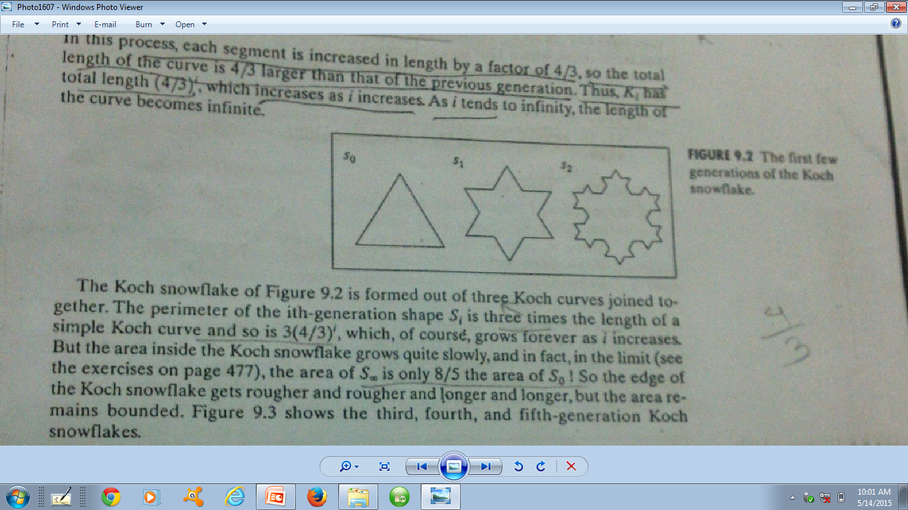
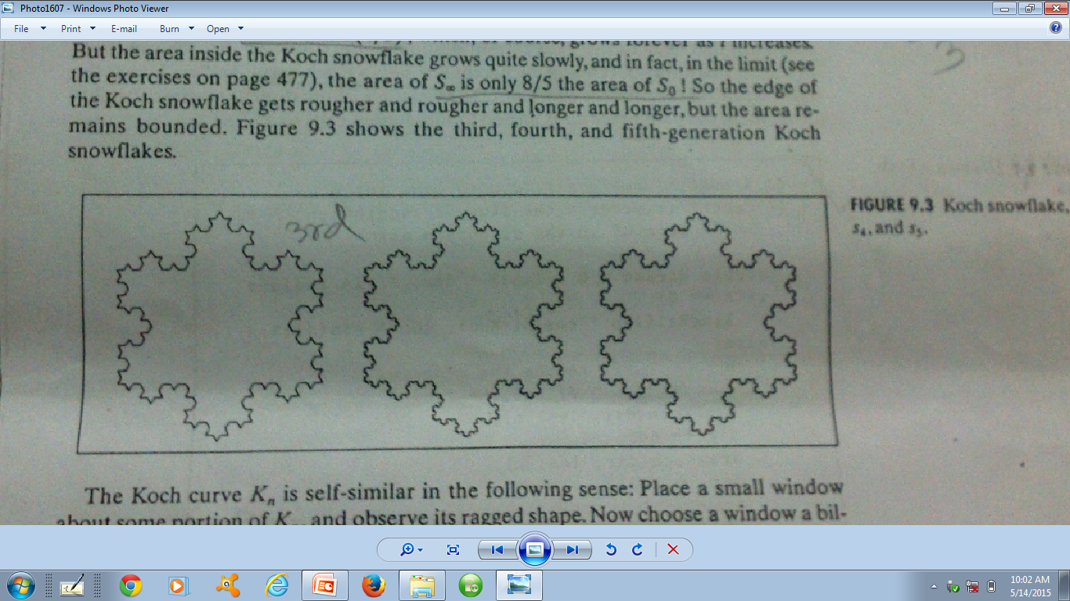
Koch Snowflake
Starts with three koch curves joined together

Slide 13
Perimeter of Koch Snowflake
Perimeter of koch snowflake curve of i^{th} generation S_{i} is three times the length of a simple koch curve
Length = 1
Perimeter= 3 x 1
Perimeter= 3 x (4/3)
Length = (4/3)
Perimeter= 3 x (4/3)²
Length = (4/3)²

Slide 14
Perimeter of Koch Snowflake
Perimeter of koch snowflake curve of i^{th} generation S_{i} is three times the length of a simple koch curve: Perimeter of S_{i} = 3 x length of k_{i} = 3 (4/3)^{i}
As i increases, perimeter increases, boundary becomes rougher
But the area remains bounded!

Slide 15
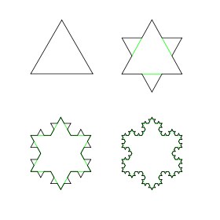
Number of Sides of Koch Snowflake
How many sides at generation n?
n₀= 3
n₁ = 4 x n₀ (=12)
n₂ = 4 x n₁ = 4 x 4 x n₀ = 4² n₀
n₃ = 4³ n₀
…
…
n_{n} = 4^{n} n₀ = 3 x 4^{n}
From each side, 4 new sides
From each side, 4 new sides

Slide 16
Size of the Sides of Koch Snowflake
Size of sides at iteration n?
S_{n} = 1/3^{n} (formula from koch curve) or L/3^{n}
Perimeter of Koch Snowflake at iteration n:
S_{n} x n_{n} = (1/3^{n}) x (3 x 4^{n})
or (L/3^{n} ) x (3 x 4^{n}) = 3L(4/3)^{n}

Slide 17
Area of Koch Snowflake
Area of S_{o} = a₀
Area of S₁ = a₀ + 3(a₀/9) = a₀ + a₀/3 = a₀(1+1/3)
How do we get area of S_{n}?
S_{o}
a₀ / 9
S₁

Slide 18
Area of Koch Snowflake
In each iteration a new bump/triangle is added at each side of previous iteration
For S₁,
# of new triangles
= # of sides in S₀
= n₀ = 3
For S₂,
# of new triangles
= # of sides in S₁,
= n₁ = 3 x 4
S₀
S₁
S₂

Slide 19
Area of Koch Snowflake
For S_{n},
# of new triangles
= # of sides in S_{n-1},
= n_{n-1} = 3 x 4^{n-1}
New area included = n_{n-1} x size of new bump/triangle
How do we get the size of each of the new bumps/triangles at n-th generation?
S₀
S₁
S₂

Slide 20
Area of Koch Snowflake
a₀/9
S₁
Area of each small bump in S₁ = a₀ / 9
Area of each small bump in S₂ = a₀ / 9²
Area of each small bump in S₃ = a₀ / 9³ … …
Area of each small bump in S_{n} = a₀ / 9^{n}
a₀/9
S₂
(a₀/9)/9 = a₀/9²

Slide 21
Area of Koch Snowflake
For S_{n},
# of new triangles
= # of sides in S_{n-1},
= n_{n-1} = 3 x 4^{n-1}
New area included = n_{n-1} x size of new bump/triangle = n_{n-1} x S_{n} = (3 x 4^{n-1}) (a₀ / 9^{n}) = a₀ (3/4) (4/9)^{n}

Slide 22
Area of Koch Snowflake
Total area of S₁ = a₁ = Total area of S₀ + New area for S₁ = a₀ + a₀(3/4) (4/9)¹
Total area of S₂ = a₂ = Total area of S₁ + New area for S₂ = a₁ + a₀(3/4) (4/9)² = a₀ + a₀(3/4) (4/9)¹+ a₀(3/4) (4/9)²
…
Total area of S_{n} = a_{n} = a_{n-1} + a₀(3/4) (4/9)^{n} = a₀ + a₀(3/4) ((4/9)¹ + (4/9)² + … + (4/9)^{n}) = a₀/5 (8 – 3(4/9)^{n})
S₀
a₀
S₁
a₁
S₂
a₂

Slide 23
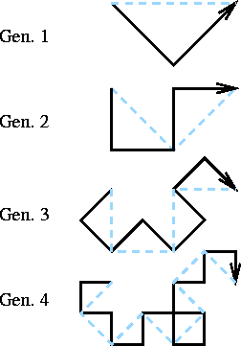
Dragon Curve
Starting from a base segment, replace each segment by 2 segments with a right angle and with a rotation of 45° alternatively to the right and to the left.
Gen. 0

Slide 24
Dragon Curve
Length
Gen 0: L; Gen 1: 2 x (L/√2) = √2 L; Gen 2: 2 x (2 x (L/√2)/√2)
= L (2 x 2 / 2) = 2 L; … Gen n: (√2)^{n} L
Gen. 0

Slide 25
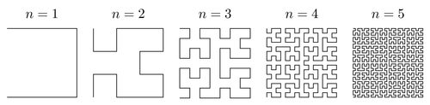
Hilbert Curve
Hilbert proved that, as the order tends to infinity, the infinitely thin, continuous line of the curve passes through every point of the unit square.

Slide 26
Dimension of Fractals
Fractals have infinite length but occupied in finite region
Lets apply this concept for simple line, square, and cube.
A straight line having unit length is divided into N equal segments, then length of each side is r = 1/N
A square having unit length sides, divided into N equal squares, then side of each small squares is r = 1/(N)^{1/2}
For N=4, we see
Similarly, a cube having unit length sides if divided into N equal cubes, then each side will have length r = 1/(N)^{1/3}
r = 1/N^{1/D}
D= Dimension
½ → 1/(4)^{1/2}
1

Slide 27
Dimension of Fractals
r = 1/N^{1/D}
N^{1/D} = 1/r
log N^{1/D} = log (1/r)
(1/D) log N = log (1/r)
D = log N / log (1/r)

Slide 28
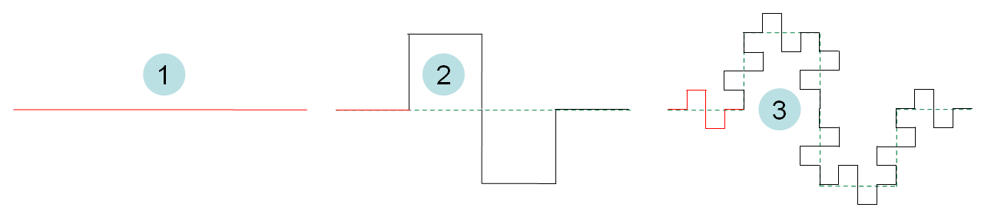
Dimension of Fractals
Koch Curve:
k₀ to k₁ → the base segment is divided into N = 4 equal segments each having length r = 1/3
So dimension is D = log N / log (1/r) = log 4 / log (3) = 1.26
Quadratic Koch Curve:
Q₀ to Q₁ → the base segment is divided into N = 8 equal segments each having length r = 1/4
So dimension is D = log N / log (1/r) = log 8 / log (4) = 1.5

Slide 29
Dimension of Fractals
Dragon Curve:
d₀ to d₁ → the base segment is divided into N = 2 equal segments each having length r = 1/2^{1/2}
So dimension is D = log N / log (1/r) = log 2 / log (2^{1/2}) = 2 → dimension of square!

Slide 30
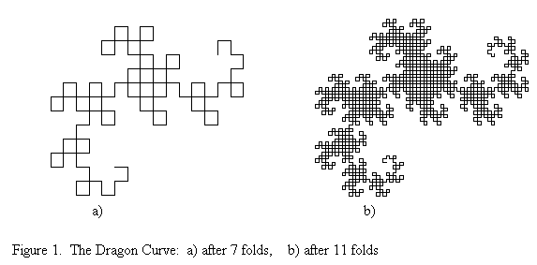
Dimension of Fractals
So what we have learned?
Koch curve has dimension 1.26
Quadratic koch curve has dimension 1.5
Dragon curve has dimension 2
Curve becomes more plane filling as the dimension increases

Slide 31
Peano Curves
Fractal curves that have dimension 2 are called Peano curves
Dragon curve
Gosper curve
Hilbert curve

Slide 32
String Production Rule to Draw Fractals
The pseudocode can be converted to a set of String Production Rules (L-System)
Koch Curve
F → F – F + + F – F
F = go forward
– = turn left through angle A degrees [A = 60]
+ = turn right through angle A degrees [A = 60]
Notes:
Lindenmayer system

Slide 33
String Production Rule to Draw Fractals
Koch Curve : F → F – F + + F – F
This gives us first generation
k₁ = F – F + + F – F
Replacing each F with same rules gives k₂
k₂ = (F – F + + F – F) – (F – F + + F – F) + + (F – F + + F – F) – (F – F + + F – F)
Applying repeatedly gives latter generations
60
F
→
F
–
F
+
+
F
–
F
60
60
60

Slide 34
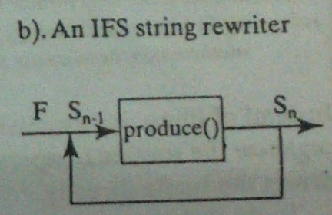
String Production Rule to Draw Fractals
This technique is called Iterated Function System (IFS)
A string is repeatedly fed back into the same function to produce the next higher order object

Slide 35

Allowing Branching
String production rule with special symbol for saving current state and restore to saved state
Current State
Current position, CP
Current direction, CD
Saving current state: [
Restore the last saved state: ]
Implementation: Using Stack
Save state: Push
Restore last saved state: Pop

Slide 36
Allowing Branching
Example: Fractal Tree
F → “FF – [ – F + F + F ] + [ + F – F – F ] ”
Atom : F
Angle A: 22º
Replace each F by the same rule
P₁
P₂
D₁
D₂
Gen 1
Gen 2
Saved State, Current State =
P₁, D₁
Ø, P₁
P₂, D₂
Ø, P₂

Slide 37
Thank you ☺

